Slide 1
SC2001 Lab 2
Team 4 LOW ZHAN QI, JODIUS
TAN SHIRLEY
AARON LIM WEE HIM

Slide 2
Table of contents
01
02
03
Dijkstra’s
Algorithm
Theoretical Analysis
Analysis –
Array
04
05
Analysis –
Minimizing Heap
Comparison

Slide 3
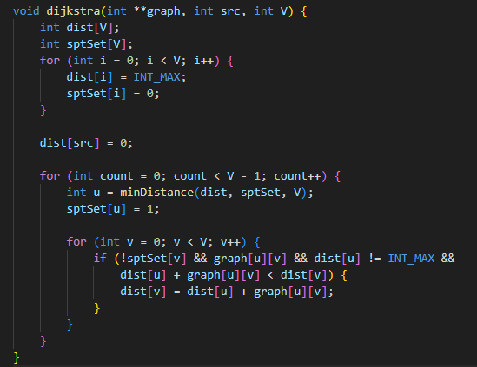
01 – Dijkstra’s Algorithm
Programming Language: C
According to lecture notes implementation

Slide 4
02 - Theoretical Analysis
 | Time Complexity
Priority Queue – Array Adjacency Matrix | O(|V|^2)
Priority Queue – Minimizing Heap Adjacency List | Insertion + Decrease Key O(|V| * log(|V|)) + O(|E| * log(|V|)) = O((|V| + |E|) * log(|V|))

Slide 5
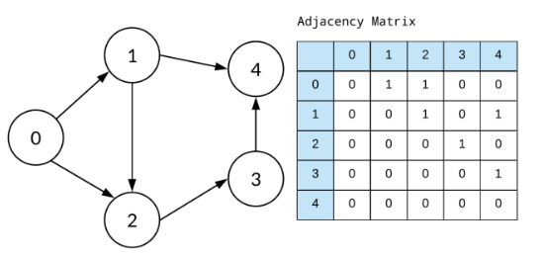
03 – Adjacency Matrix with Array
Only compare with V as for adjacency matrix as for this case even if it is 0 we will still need to compare it

Slide 6
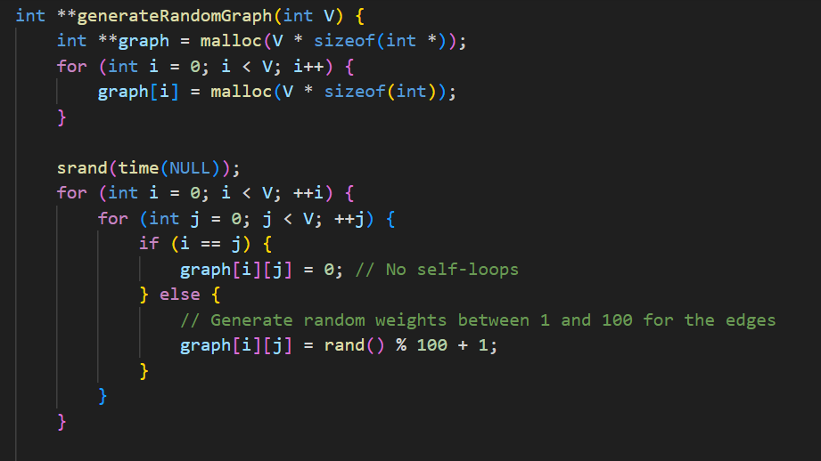
03 – Adjacency Matrix with Array
For our case we make it such that the graph is a complete graph with every edge having a random generated weight.

Slide 7
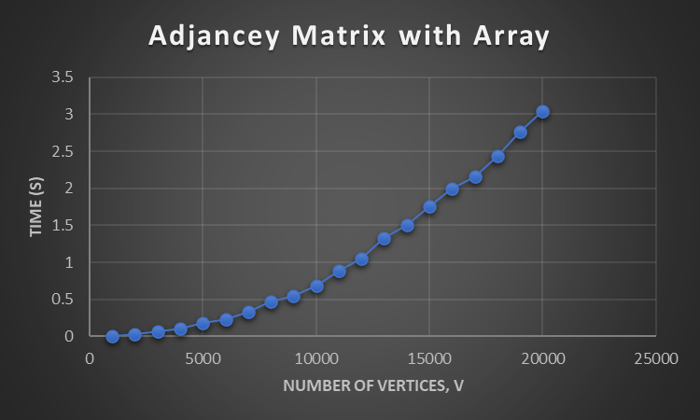
03 – Adjacency Matrix with Array
Time Complexity – O(|V|^2)

Slide 8
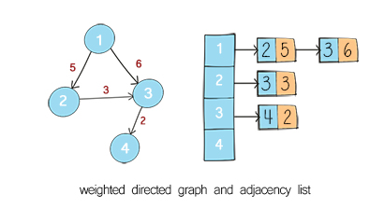
Part B)

Slide 9
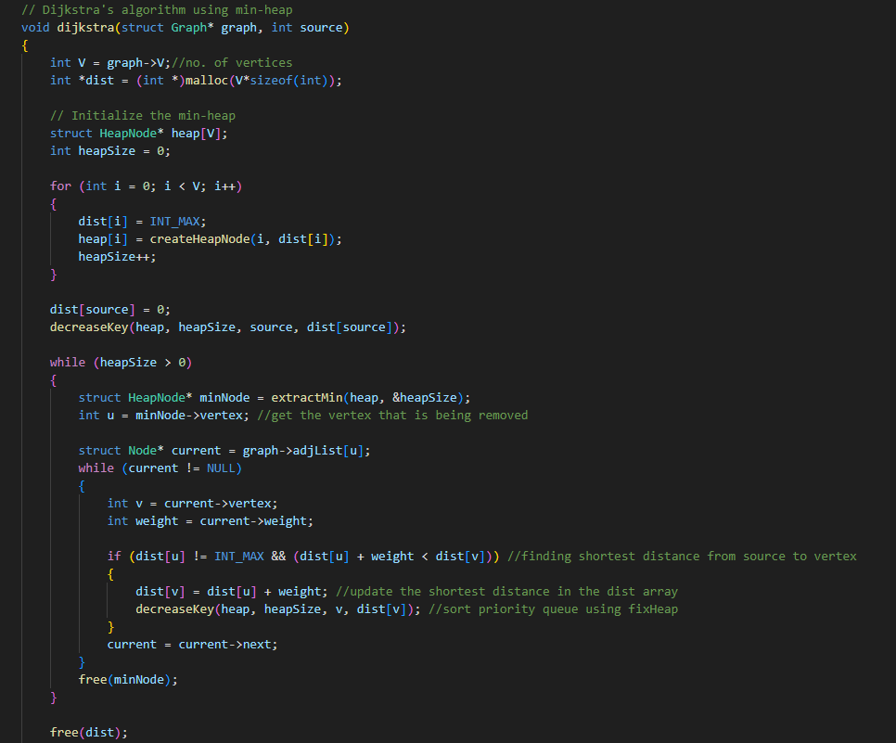
04 – Adjacency List with Minimizing Heap
implemented according to lecture notes

Slide 10
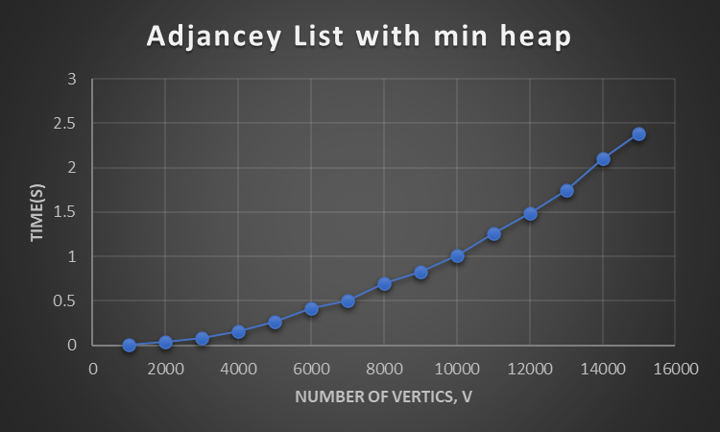
04 - Time complexity Analysis
For worst case: |V| iterations
Selection of vertex with min. dist = O(log|V|)
For each iteration must consider all the edges, |E|
Thus the overall time complexity is as shown: O((|V| + |E|) * log(|V|))
Follows nlogn graph

Slide 11
Part C Sparse Graph & Dense Graph

Slide 12
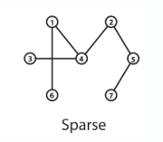

05 – Adjacency List with Minimizing Heap
(Sparse Graph)
Number of edges E << Max possible edges given by
Min value of E Edge = V-1 as seen from the example
E << V^2

Slide 13
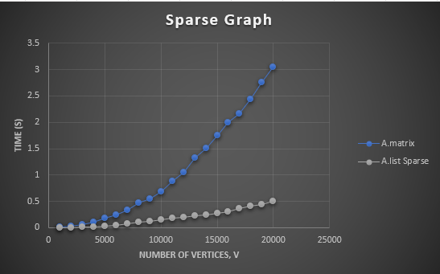
05 - SPARSE GRAPH RESULT
Time complexity of the matrix: O(|V|^2)
Time complexity in b) = O((|V| + |E|) * log(|V|))
Since O((|V| + |E|) * log(|V|)) << O(|V|^2)
For sparse graph, the Dijkstra’s algorithm with adjacency list with min heap is faster

Slide 14
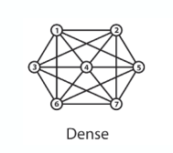
05 – Adjacency List with Minimizing Heap
(Dense Graph)
Dense graph edges can be approximated to complete graph edges
Number of edges for complete graph is
Thus no. of edges for dense graph |E| = O(|V|)^2

Slide 15
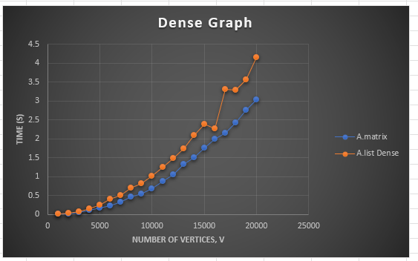
05 -DENSE GRAPH RESULT
Since |E| = O(|V|^2), the time complexity from b) can be modified to be
O((|V|+|V|^2)log|V|)
Time complexity of a) = O(|V|^2)
Since O((|V|+|V|^2)log|V|) >> O(|V|^2)
Dijkstra’s algorithm with adjacency matrix and priority queue is faster

Slide 16
05 – Comparison
Dense graph: Adjacency matrix performs better
Time complexity Matrix : O(|V|^2)
Time complexity List: O(|V|^2*log(|V|))
Sparse graph: Adjacency list performs better
Time complexity Matrix : O(|V|^2)
Time complexity List: O((|E|)+(|V|))*log(|V|))

Slide 17
Thank you

